Slide 1






CSA0491-Operating Systems for process Scheduling
Real-Time
Operating System Support in a Multimedia Communication system
Project by:
S. Sandeep Kumar Reddy (192210010)
P. Sai Kumar (192211420)
C. Sandeep Reddy (192211966)
Operating System
SSE, SIMATS
Guided by:
Dr.E. k. Subramaniam
(Course Faculty)
Operating System
SSE,SIMATS

Slide 2


Abstract
The integration of real-time operating system (RTOS) support within a multimedia communication system is pivotal for ensuring efficient and seamless data processing and transmission. This paper delves into the significance of RTOS in enhancing the performance of multimedia communication systems, particularly in handling time-sensitive tasks. It explores the architecture and functionalities of RTOS, emphasizing its role in facilitating real-time data processing and scheduling tasks based on priority levels. The study highlights the challenges and complexities involved in implementing RTOS within multimedia communication systems and proposes strategies to optimize its utilization, thereby improving system reliability and responsiveness.
Keywords: Real-Time Operating System, Multimedia Communication System, Data Processing, Task Scheduling, System Reliability.

Slide 3


Introduction
Real-Time Operating System (RTOS) support enhances responsiveness and predictability in multimedia communication systems.
RTOS integration ensures timely processing of tasks critical for multimedia data handling.
It facilitates seamless synchronization and coordination of various multimedia components, such as audio, video, and network protocols.
With RTOS, prioritization and scheduling of tasks become more efficient, reducing latency and ensuring smooth real-time performance.
Overall, RTOS support optimizes system reliability and stability, crucial for delivering high-quality multimedia communication experiences.

Slide 4





Hardware and software requirements
Hardware
Software
Package
1)Processor:11th Gen Intel(R) Core(TM) i5-11400H @ 2.70GHz 2.69 GHz64-bit operating system, x64-based processor
2)Storage:512 GB
3)Memory:8 GB
4)Graphic card:In-built Radeon Graphics
1)OS:Windows 10 or 11
2)Python:3.12.6
3)Integrated development environment(IDE):
Visual Studio
1)Request library for the use of Random Package
2)And Other Packages such as Queue,Time and Threading

Slide 5


Existing System
Real-time task scheduling ensures timely execution of multimedia tasks.
Priority-based scheduling guarantees that critical tasks receive precedence.
Efficient memory management for storing multimedia data and buffers.
Synchronization mechanisms to coordinate data flow among tasks.
Resource reservation mechanisms to allocate CPU, memory, and network bandwidth.

Slide 6


Proposed System
Implement priority-based scheduling algorithms to ensure timely processing of multimedia data.
Utilize efficient memory management techniques to handle large volumes of multimedia data.
Incorporate real-time task synchronization mechanisms for seamless coordination among various system components.
Provide robust error handling and recovery mechanisms to maintain system stability and reliability.
Support hardware acceleration for multimedia processing tasks to enhance system performance and efficiency.

Slide 7
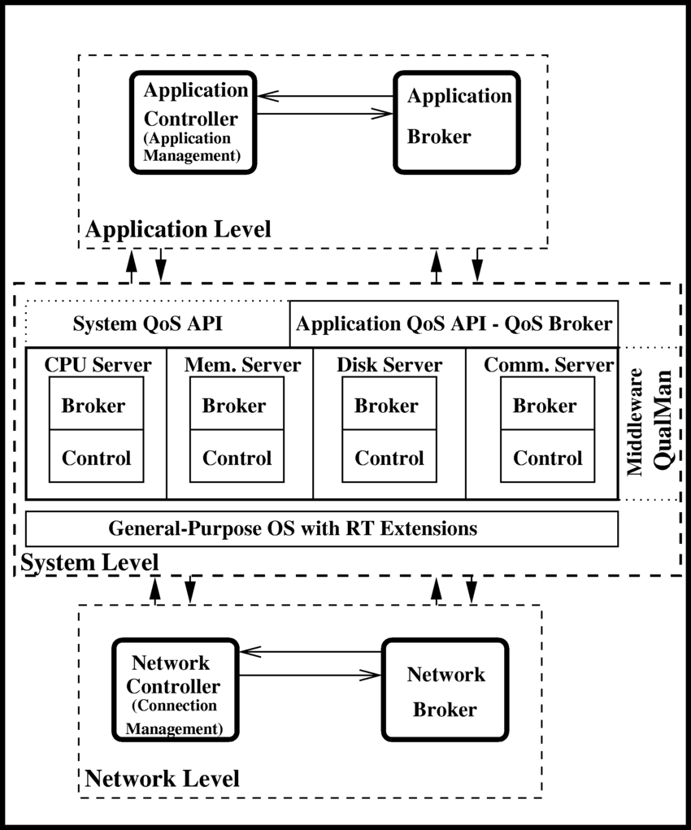
Architecture

Slide 8


Testing
Conduct comprehensive testing procedures for Real-Time Operating System (RTOS) support within the multimedia communication system.
Evaluate RTOS performance under varying multimedia loads and communication scenarios.
Test real-time task scheduling and prioritization capabilities of the RTOS to ensure smooth multimedia data processing.
Assess the system's ability to handle concurrent multimedia streams without compromising performance or quality.
Validate the responsiveness of the RTOS in handling multimedia events such as audio/video synchronization and data packet prioritization.
Verify the reliability of the RTOS in maintaining continuous communication channels for multimedia data transmission.
Evaluate system stability under peak loads and stress conditions to ensure uninterrupted multimedia communication.

Slide 9


Implementation
TASK SCHEDULING BASED ON PRIORITY LEVELS FOR REAL-TIME RESPONSE.
Efficient management of resources such as CPU, memory, and I/O devices.
Support for multimedia data streams with time constraints.
Implementation of synchronized communication protocols for multimedia data transmission.
Integration of real-time networking protocols to ensure timely delivery of data packets.
Utilization of specialized algorithms for buffering and data processing to meet strict timing requirements.
Monitoring and management of system parameters to guarantee continuous operation within real-time constraints.
Implementation of fault tolerance mechanisms to handle system failures without compromising real-time performance.

Slide 10
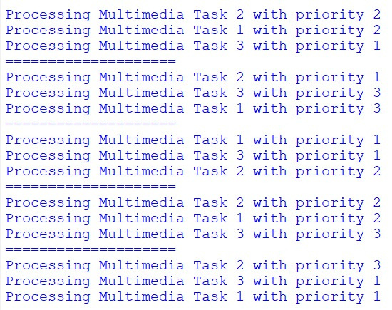
Final Output

Slide 11
Conclusion
In conclusion, the integration of real-time operating system (RTOS) support within a multimedia communication system offers significant advantages. By leveraging RTOS capabilities, such systems can ensure timely processing and delivery of multimedia data, enhancing overall performance and user experience. The seamless coordination facilitated by RTOS enables smooth synchronization of diverse media streams, optimizing resource utilization and minimizing latency. Moreover, RTOS support enhances system reliability and robustness, crucial for mission-critical applications. Overall, the incorporation of RTOS in multimedia communication systems represents a pivotal advancement, promising enhanced efficiency, reliability, and real-time responsiveness in complex communication environments.

Slide 12
Future Scope
Real-time operating system (RTOS) integration ensures timely processing of multimedia data in communication systems.
Enhanced support for multimedia streaming, ensuring minimal latency and jitter for real-time delivery.
Improved system reliability and stability through deterministic scheduling and resource management.
Facilitation of seamless integration with diverse multimedia devices and protocols.
Potential for advanced features such as prioritized data handling, dynamic bandwidth allocation, and Quality of Service (QoS) optimization.
Future developments may focus on enhancing RTOS capabilities for emerging multimedia formats and communication technologies, fostering greater efficiency and scalability.

Slide 13
Literature survey
Real-time operating system (RTOS) support plays a crucial role in ensuring the seamless operation of multimedia communication systems. These systems require precise timing and scheduling mechanisms to handle various types of media streams, such as audio, video, and data, in real time. A literature survey reveals a plethora of research efforts focusing on optimizing RTOS functionalities to meet the stringent requirements of multimedia communication systems. Key areas of investigation include scheduling algorithms, resource management techniques, and performance evaluation methodologies tailored specifically to the demands of multimedia applications. By analyzing existing literature, researchers aim to identify trends, challenges, and opportunities for further advancements in RTOS support for multimedia communication systems, ultimately contributing to enhanced reliability, efficiency, and quality of service in real-time multimedia applications.

Slide 14
Reference
Nicolaou, Cosmos. "An architecture for real-time multimedia communication systems." IEEE Journal on selected areas in communications 8.3 (1990).
Fan, Changpeng. "Mmoss: Soft real-time operating system support in a multimedia communication subsystem." IFAC Proceedings Volumes 27.6 (1994).
Plagemann, Thomas, et al. "Operating system support for multimedia systems." Computer communications (2000).
Katcher, Daniel I., Kevin A. Kettler, and Jay K. Strosnider. "Real-time operating systems for multimedia processing." Proceedings 5th Workshop on Hot Topics in Operating Systems (HotOS-V). IEEE, 1995.

Slide 15


Team members:
M.Ram Jeyanth(192211167)
S.Hariharan(192211110)
Sahik Sharukh Khan(192211800)

